Slide 1

DIFF Process and Equipment Introduction
部门：工艺设备
主讲人：孔伟鑫
2021年6月9日

Slide 2


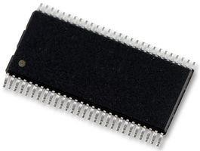







diffusion
Semiconductor - Diffusion
Diffusion
Furnace: LPCVD, Ox Growth, Anneal
IMP/RTP: implant, Ox growth, Anneal
Implant:
Ion doped
Furnace:
Screen oxide
Oxide
dopant
Wafer

Slide 3

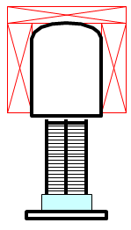
Furnace
Furnace – Process Overview
Load | Raise | Pump | Temp. | Pump | Press. | Si₃N₄ | Pump | N₂ | Lower | Unload
Wafer | Tower | Down | Stab. | Down | Stab. | Dep. | Down | Vent | Tower | Wafer
Chamber Temperature
Wafer
Temperature
Gas Flow Pressure
Boat Position

Slide 4
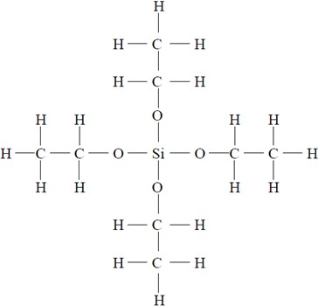
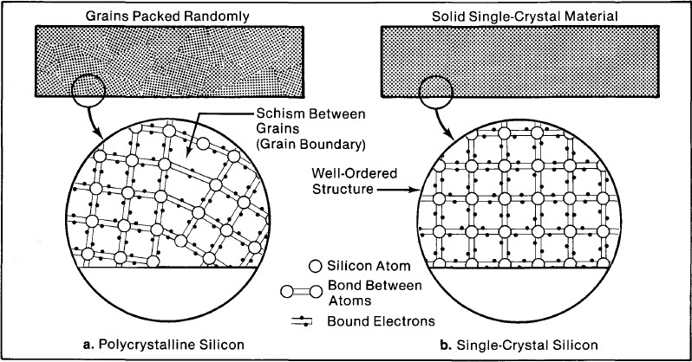
Furnace
Furnace - LPCVD Process
Oxide(SiO2)-TEOS oxide
Nitride(SiN): 3 SiH₂Cl₂ + 4 NH₃ → Si₃N₄ + 6HCl + 6H₂
Polysilicon(Poly-Si):SiH4(g) → Si(s) + 2 H2(g)

Slide 5
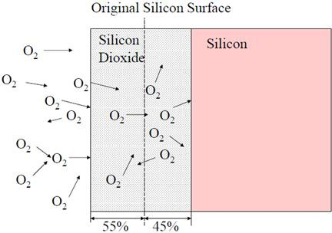
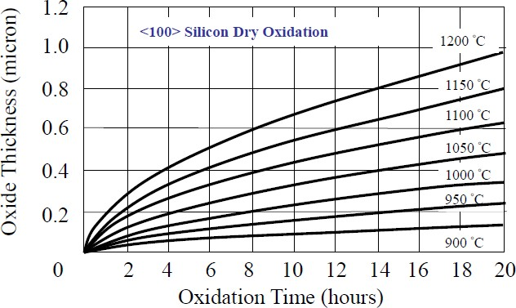
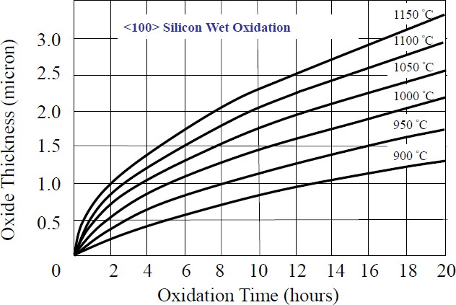
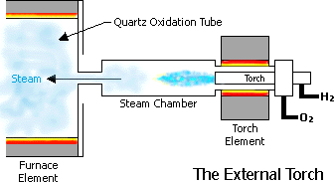
Furnace
Furnace – Oxidation Process
Dry Ox: Si + O₂ → SiO₂
Wet Ox: H2 + O2 → H2O; Si + 2H2O → SiO2 + 2H2

Slide 6
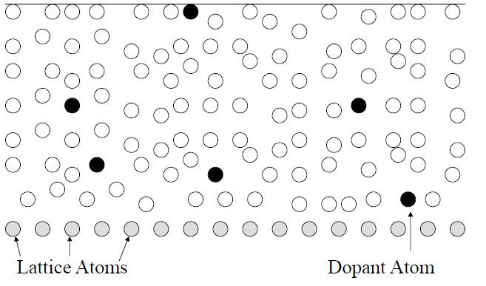
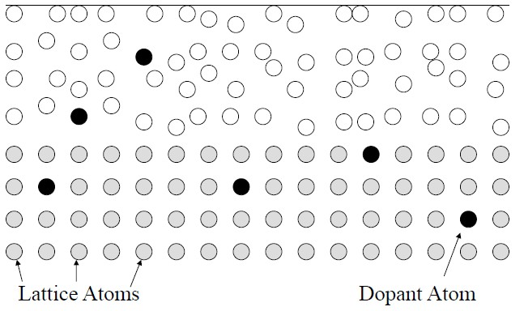
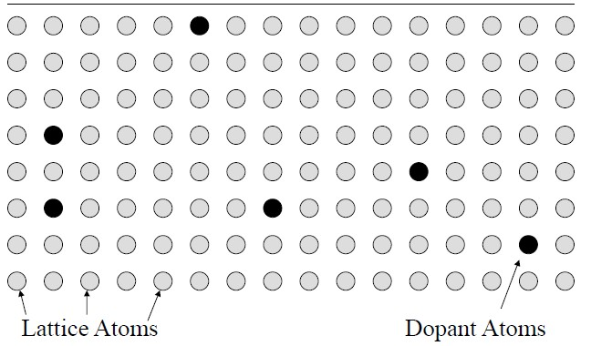
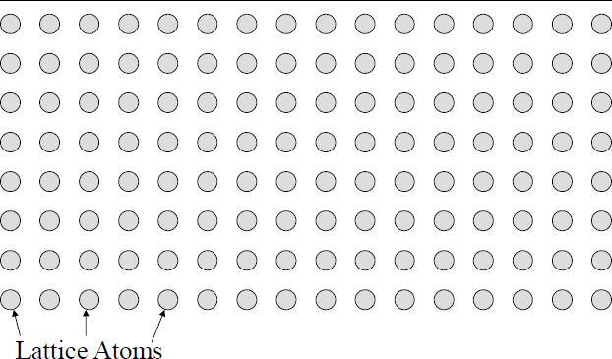
Furnace
Furnace – N2 anneal
修复晶格
提高均匀性
提高致密性

Slide 7
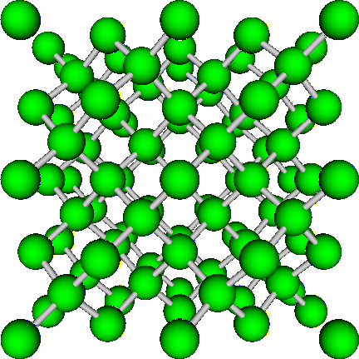
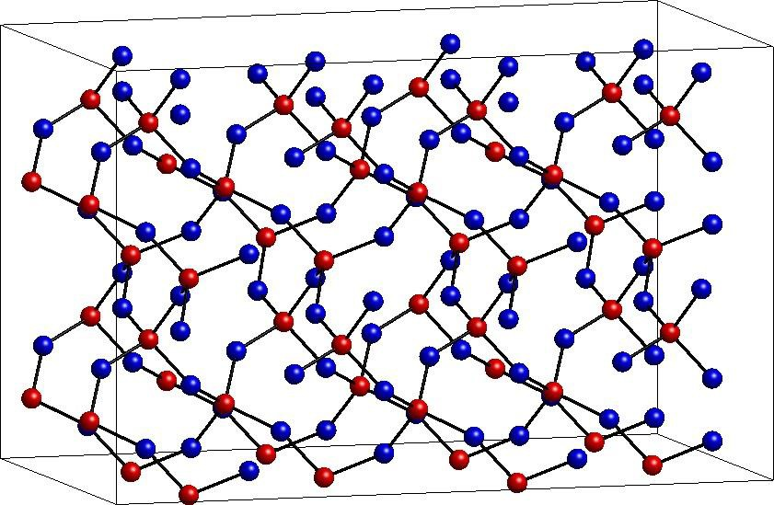


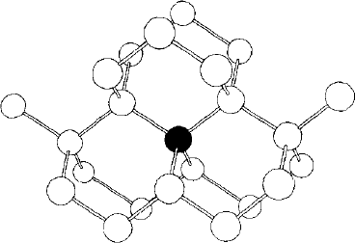
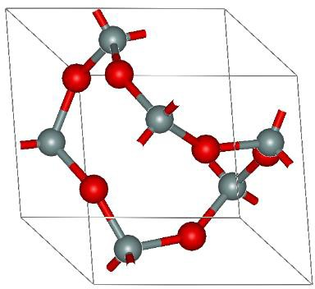
Furnace
Furnace – H2 Anneal
Poly结晶
修复晶格
Si
SiO2
H
H

Slide 8
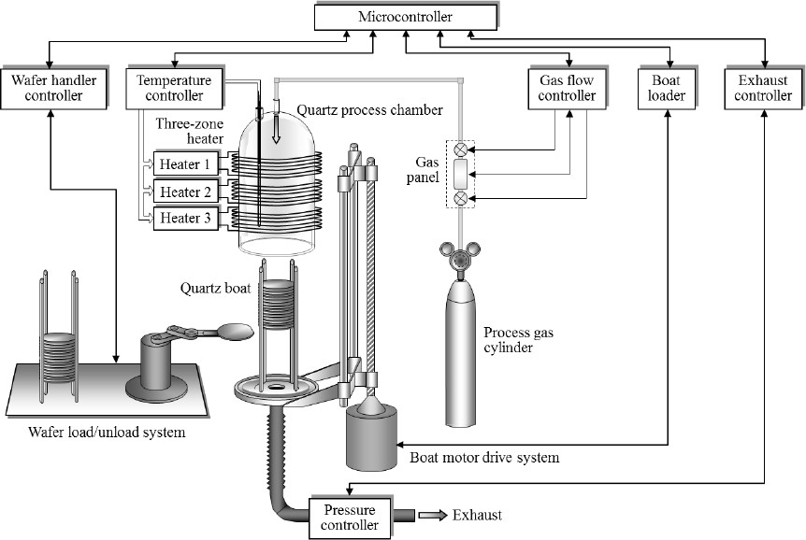
Furnace
Furnace – Equipment Overview

Slide 9
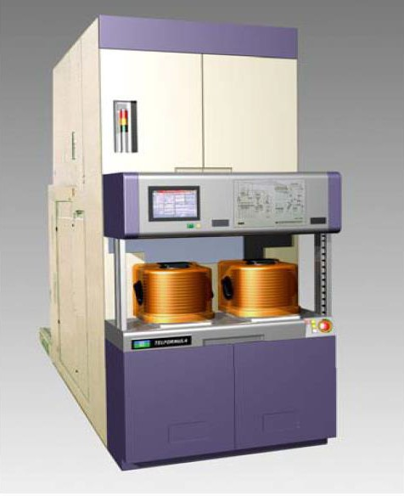
Furnace
Furnace – Formula(SiN)

Slide 10
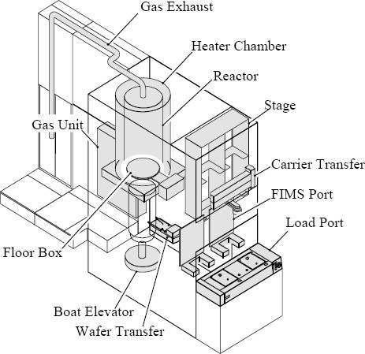

Furnace
Furnace- Formula
Load port：FOUP 进出机台的地方
FIMS port：Wafer Charge and Discharge 处 Stage：机台存放FOUP 的地方
Carrier Transfer：把FOUP: load port – stage or
Load port – FIMS port
Wafer Transfer：Wafer FIMS port -> boat Boat Elevator：控制Boat上升下降
Shutter：当Boat下来, 避免Process chamber热散失 Reactor：Process chamber
Heater Chamber：加热区 Gas Exhaust：排放气体管线
Gas Unit：气体管线收集区
Shutter

Slide 11
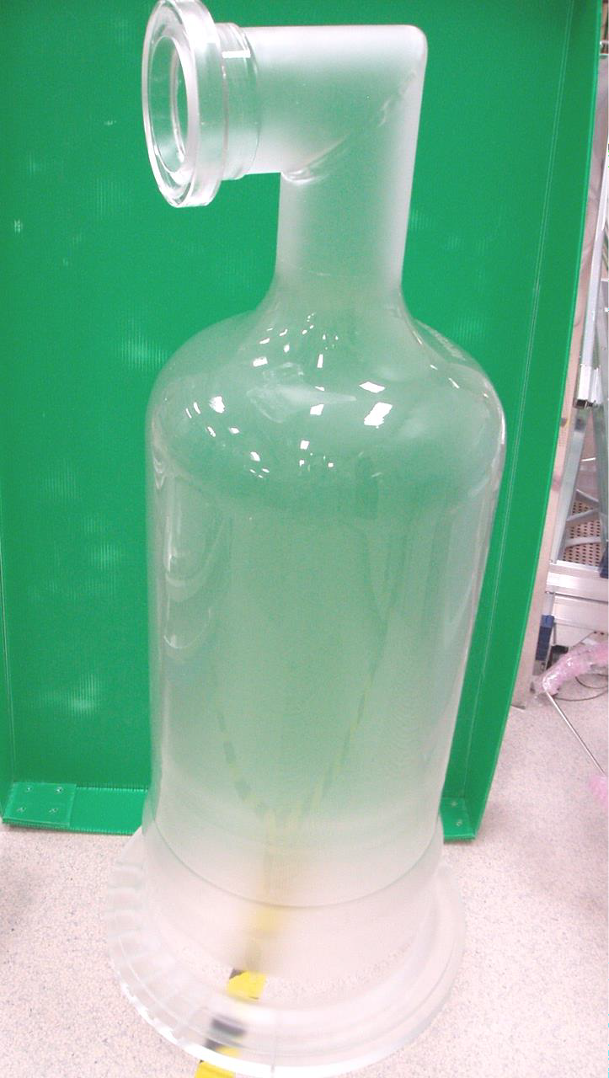
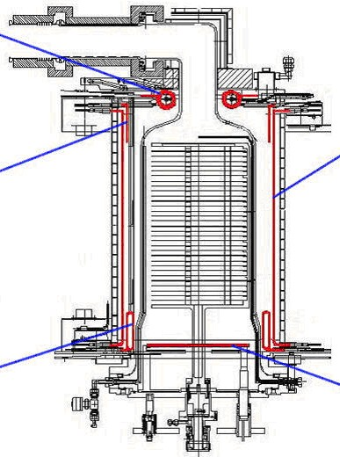

Furnace
Furnace- Formula Heater
TOP Spiral Heater
Exhaust Vent
TOP-SP
TOP-S
TOP sub Heater
Main Heater
MAIN
BTM-S
BTM-TP
BTM sub Heater
BTM TP Heater

Slide 12

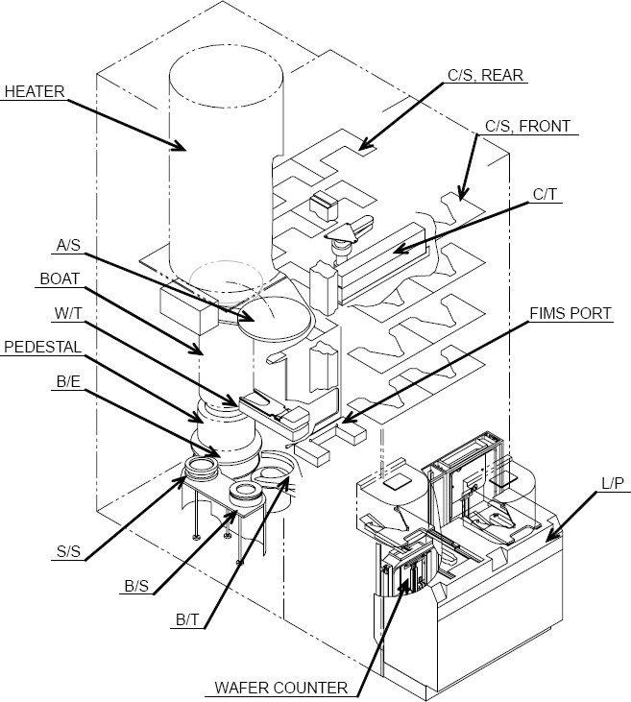
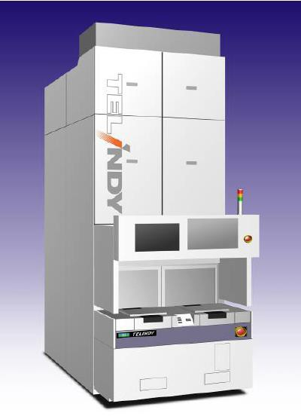
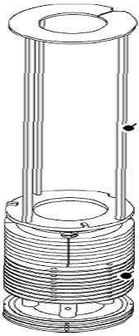


Furnace
Furnace - TEL Indy(TEOS/SiN/ oxidation)
Carrier storage
Auto Shutter
Carrier transfer
Boat
Wafer Transfer Pedestal
FIMS Port
Boat Elevator
Load Port
Second Storage
Boat Storage
Transfer
Wafer Counter

Slide 13

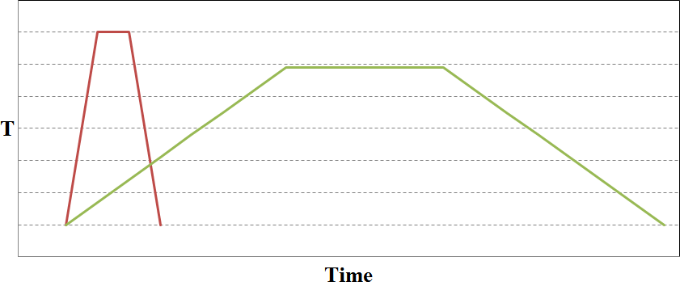
Rapid thermal process
RTP – Comparison with Furnace
RTP
Furnace

Slide 14

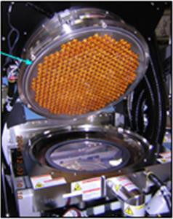













Rapid thermal process
RTP – chamber structure(AMAT)
Lamp
Process Gases
Wafer
reflector
Temperature probe

Slide 15
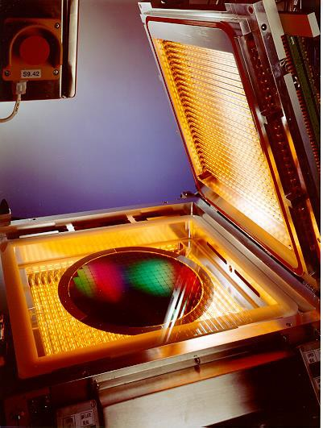
Top Lamps
Rapid thermal process
RTP – chamber structure(Mattson)
Bottom
Lamps
Wafer

Slide 16
Rapid thermal process
RTP – Process & Equipment
Process
Rapid Thermal Anneal(RTA)
Rapid Thermal Oxidation(RTO)
Rapid Thermal Nitridation(RTN)
Hardware
Applied Centura (ISSG)
Applied Vantage (RTA/RTO)
Mattson Helios(RTA)

Slide 17
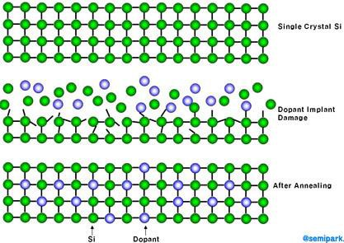
Rapid thermal process
RTP – RTA

Slide 18


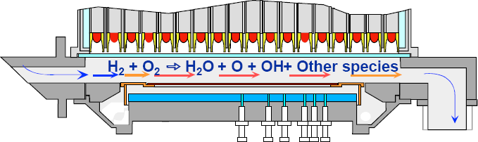
Rapid thermal process
RTP - RTO
Dry Ox: Si + O₂ → SiO₂
Wet Ox(ISSG): H2 + O2 → H2O ; Si + 2H2O → SiO2 + 2H2
Reaction Mechanism
ISSG :In-Situ Steam Generation
better leakage properties,gate oxide integrity,and reliability over furnace oxidation techniques
at high temp and low pressure, a mix of water vapor, OH
radicals, O radical and other species is formed at wafer surface
H₂ + O₂ → 2OH
H₂ + OH → H₂O + *H
O₂ + *H H₂ + *O
OH + *O
OH + *H
^{H2}(g), ^{O2}(g)

Slide 19



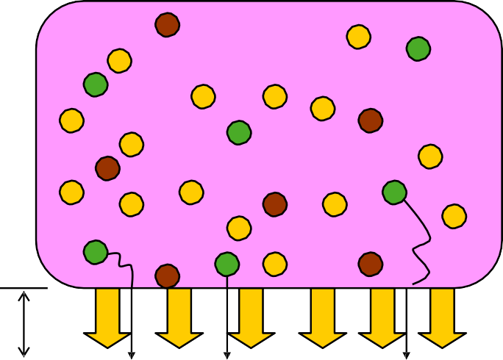


Rapid thermal process
RTP - Nitriding
RTN & SPA
NO | LAMP SiO2 Silicon | — Electron + N ion N radical Self bias |  | + － + | SPA — Plasma + － － + SiO2 Si | － + － | +

Slide 20

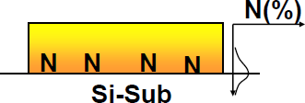
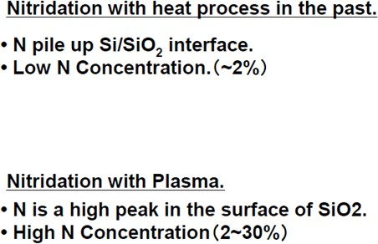
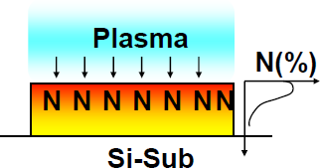
Rapid thermal process
RTP – Nitrogen distribution

Slide 21

Rapid thermal process
RTP – Hardware introduction
① AMAT （Centura/Vantage）机台
旋转方式：磁悬浮承载，240rpm；
测温方式：下方装有7根pyrometer；
加热模式：上部加热（409个灯泡，15个区域）；
可以调节灯泡的温度来控制process的区域温度。

Slide 22

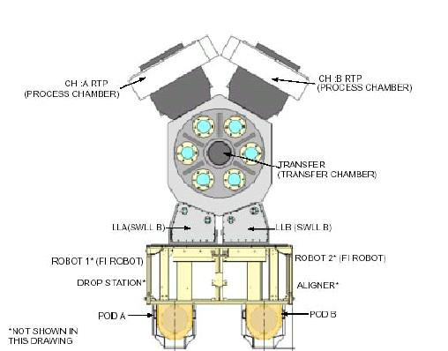
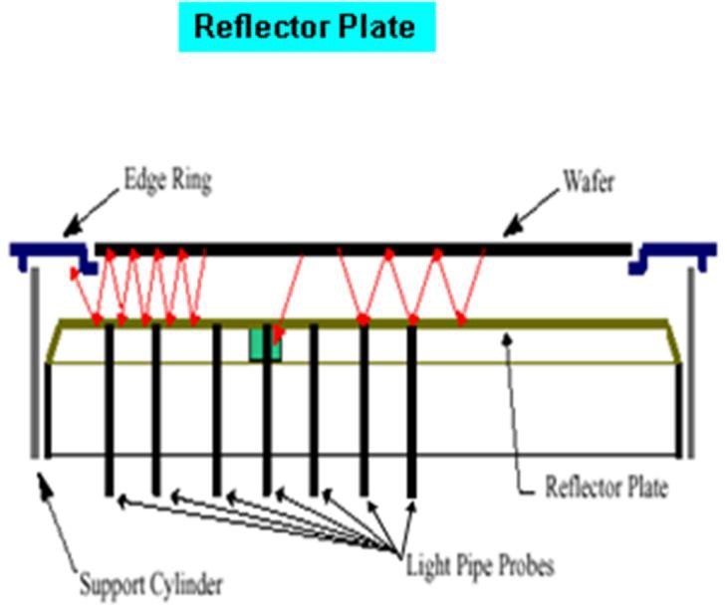
Rapid thermal process
RTP – Hardware introduction
Centura机台：Load port、Factory interface、Load lock、
Mainframe、Process chamber

Slide 23

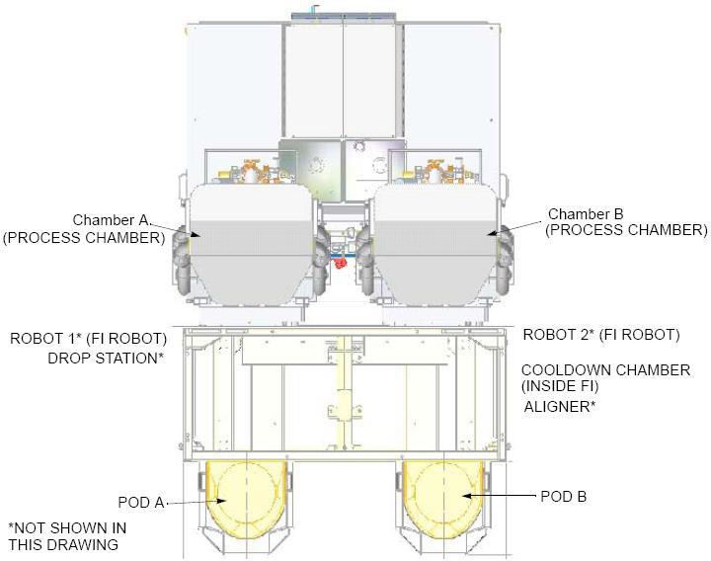
Rapid thermal process
RTP – Hardware introduction
Vantage机台：Load port、Factory interface、Process chamber

Slide 24

Rapid thermal process
RTP – Hardware introduction
② Mattson Helios 机台
旋转方式：气动控制，90rpm ；
测温方式： pyrometer ；
加热方式：双面加热（上下方各有28个Lamps加热）。

Slide 25

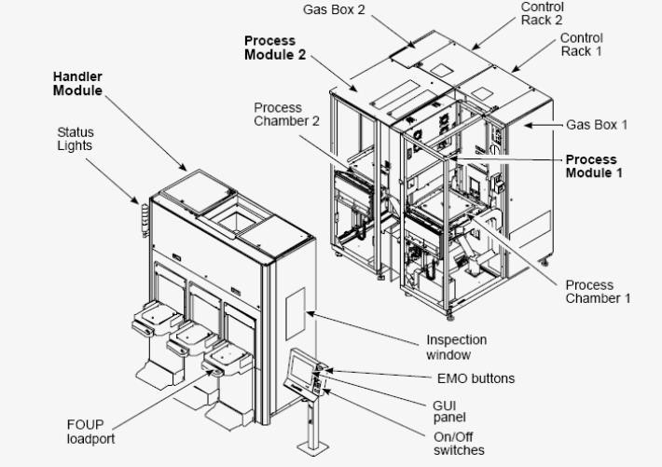
Rapid thermal process
RTP – Hardware introduction
Mattson机台：Lord port、Handler Module、Chamber、Cooling station

Slide 26

Implantation
Implant – thermal diffusion v.s. implantation
Doped region
PR
Si
SiO₂
Si
Thermal diffusion
Ion implantation

Slide 27

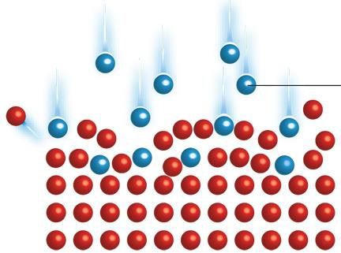
Implant – beam line overview
Suppression Electrode
Analyzer Magnet
Vacuum
Pump
Ion
Source
Beam
Line
ion
Extraction Electrode
Post Acceleration
Electrode
Vacuum Pump
Wafers
Plasma Flooding System
End Analyzer
Si

Slide 28
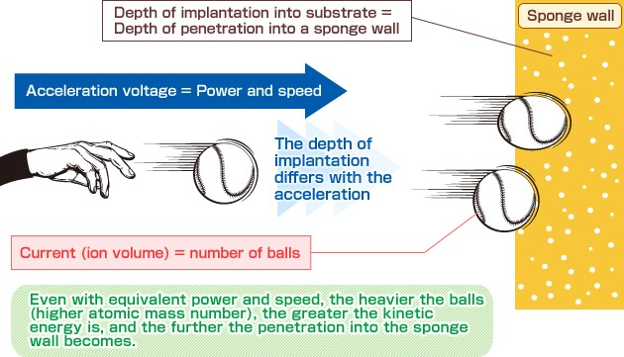
Implantation
Implant – bombard energy

Slide 29

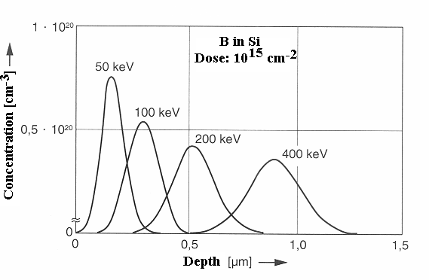
Implantation
Implant – dopant distribution
Rp

Slide 30

Implant – Shadow effect
Ion Beam
Polysilicon
Doped Region
Substrate
Shadowed Region

Slide 31



Implant – Channel effect
Lattice Atoms
Channeling Ion
Collisional Ion
θ
Wafer Surface

Slide 32
IMP机台类型和构造
Implant简介及机台构造
Implant – Hardware introduction
① 根据功率分类(目前我们公司的机台)
中电流机型：VIISTA 810EHP（AMAT）
能量：2~300KeV；剂量范围：1E11~1E15 ion/cm2
高电流机型：HCS （AMAT）
能量：0.5~80KeV；剂量范围：2E13~1E17 ion/cm2
高能量机型：HE3（AXCELS）
能量：40~4600KeV；剂量范围：5E11~1E15 ion/cm2
② 根据生产方式分类
单片晶圆
批量生产

Slide 33

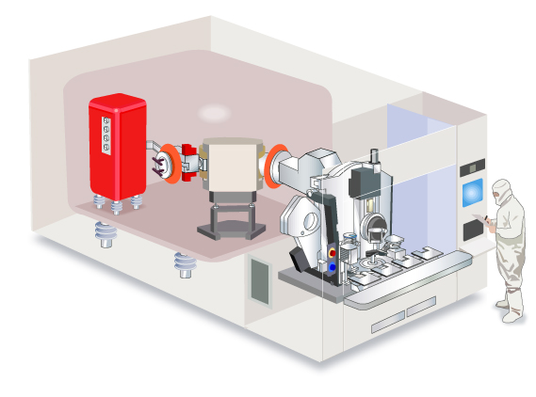
Implantation
Implant – Hardware introduction
③ 机台的主要组成部分
通过磁场筛选出目标离子
束流计测
（FARADAY)部
质量能量分析部
通过中和电子的数量测量离子束流
其他支持系统
离子源部
Ion Source
通过加热、电离、碰撞的过程将气体、固体杂质离子化
硅片搬送部
机械传送

Slide 34
感 谢 聆 听

Slide 35
Q&A
Q1. DIFF包括哪三类机台？
Q2. FUR按工作压力可以分为哪些类型？
Q3. AP炉管Oxidation Process 有几种工艺？
Q4. Wet Ox是哪些气体进行点火？
Q5. Anneal 有哪些类型？
Q6. RTP是用什么加热升温？
Q7. 目前RTP设备有哪两个主流制造厂商？
Q8. IMP按功率分为哪几种类型？
Q9. IMP按生产方式分为哪些类型？
Q10. IMP会损伤晶格吗？
A1: FUR/RTP/IMP
A2: AP/LP
A3: Dry Ox/Wet Ox
A4: H2/O2
A5: N2 Anneal/H2 Anneal
A6: Lamp
A7: AMAT/Mattson
A8: MC/HC/HE
A9: Single/Batch
A10: Yes

